Slide 1
Class 8: Probabilistic weather forecasting with NNs via scoring rules

Slide 2
Outline
Motivation & Calibration
Proper scoring rules: Brier, Log, CRPS
Calibration & sharpness diagnostics
CNN architectures for probabilistic outputs
LSTM architectures for probabilistic outputs
Manual & framework implementations
Training results & calibration diagrams
Ensembles, hyperparameters & variants
Applications & best practices
Summary & further reading

Slide 3
Motivation
Point
Deterministic forecasts provide a single point estimate
Probabilistic forecasts assign a distribution to the future – essential for risk‑aware decisions
Calibration measures statistical consistency between predicted and observed distributions
Sharpness reflects the concentration of the predictive distribution; the goal is sharp and calibrated forecasts
Distribution

Slide 4
Proper scoring rules
Scoring rules evaluate probabilistic forecasts by comparing the predicted distribution to the observed value.
A scoring rule is strictly proper if the expected score is minimised when the forecast distribution equals the true distribution.
Proper scoring rules encourage calibration and discourage hedging – making too conservative forecasts.
Popularised by Gneiting and Raftery (2007)
Model | Mean | Std deviation | Observation | Scoring rule | MSE
A | 20°C | 1°C | 19°C | 1.42 | 1
B | 20°C | 3°C | 19°C | 1.94 | 1

Slide 5
Calibration and sharpness
Reliability: predicted probabilities match observed frequencies.
Sharpness: predictive distributions are as concentrated as possible.
Aim: reliability diagrams close to diagonal and narrow prediction intervals.
Reliability diagram

Slide 6
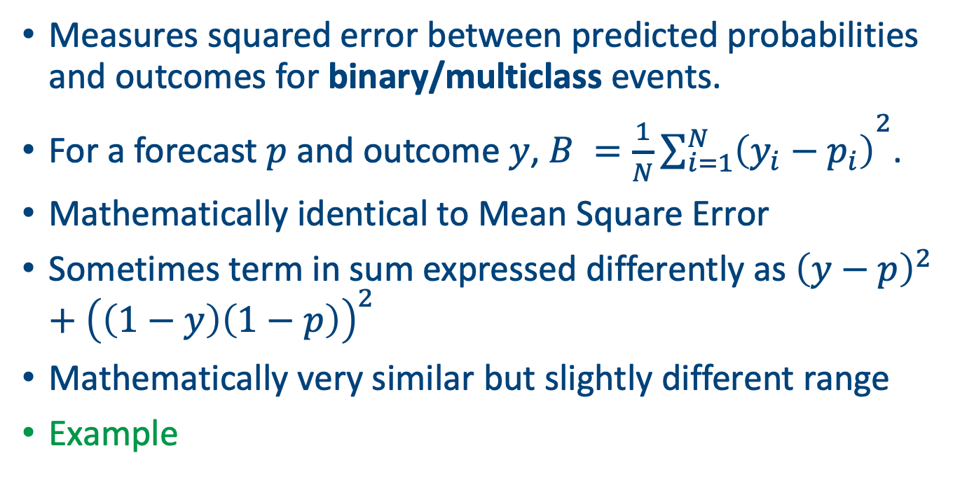
Brier score
Measures squared error between predicted probabilities and outcomes for binary/multiclass events.
For a forecast $p$ and outcome $y$, $B ={\frac{1}{N}\sum_{i=1}^{N}{\left(y_{i}−p_{i}\right)}}^{2}$.
Mathematically identical to Mean Square Error
Sometimes term in sum expressed differently as ${\left(y−p\right)}^{2}+{\left(\left(1−y\right)\left(1−p\right)\right)}^{2}$
Mathematically very similar but slightly different range
Example

Slide 7
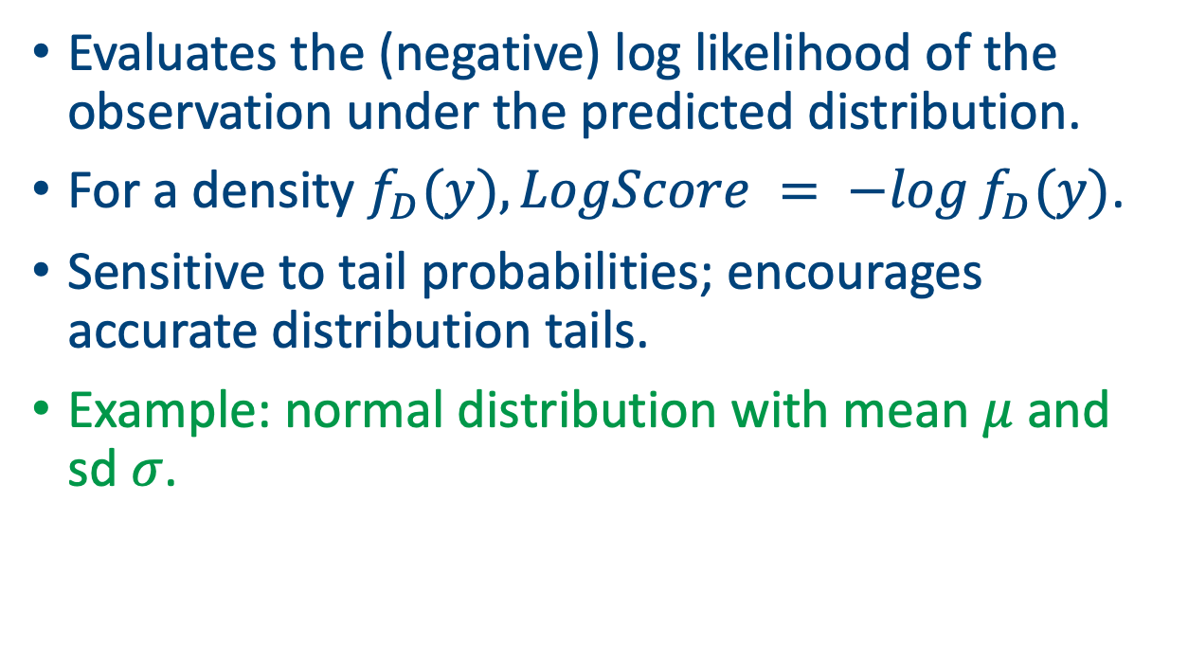
Logarithmic score
Evaluates the (negative) log likelihood of the observation under the predicted distribution.
For a density $f_{D}(y), LogScore = −log⁡f_{D}(y)$.
Sensitive to tail probabilities; encourages accurate distribution tails.
Example: normal distribution with mean $μ$ and sd $σ$.

Slide 8
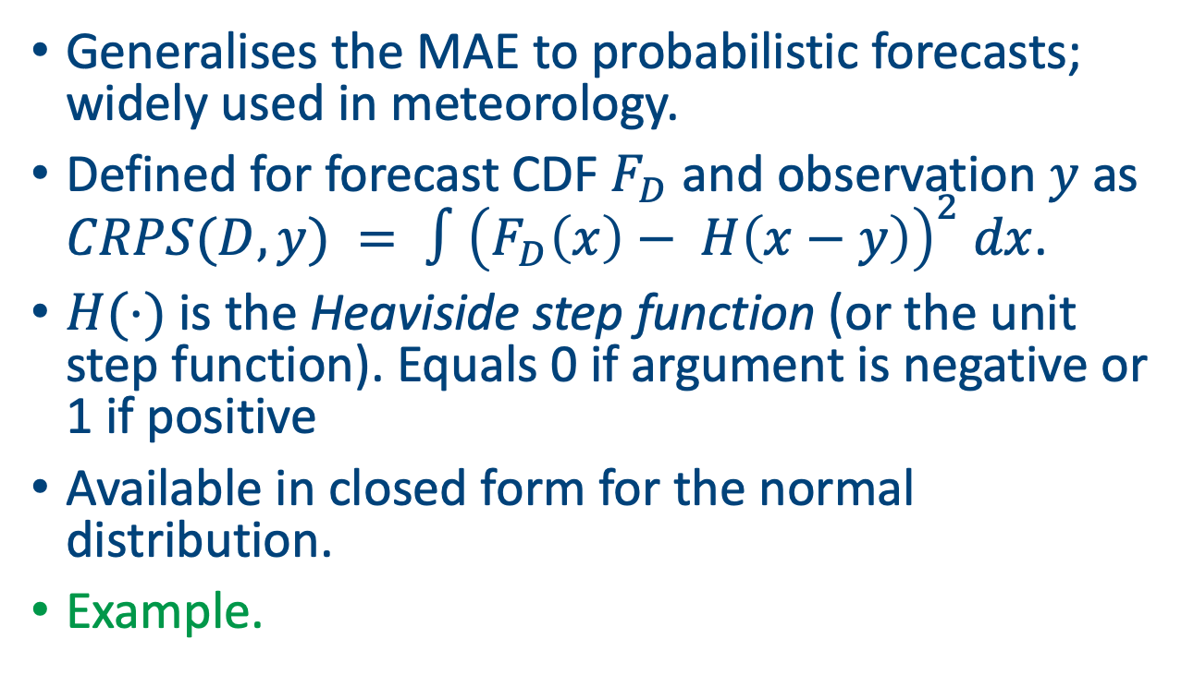
Continuous ranked probability score (CRPS)
Generalises the MAE to probabilistic forecasts; widely used in meteorology.
Defined for forecast CDF $F_{D}$ and observation $y$ as $CRPS(D,y) = ∫{\left(F_{D}\left(x\right)− H\left(x−y\right)\right)}^{2} dx$.
$H(⋅)$ is the Heaviside step function (or the unit step function). Equals 0 if argument is negative or 1 if positive
Available in closed form for the normal distribution.
Example.

Slide 9
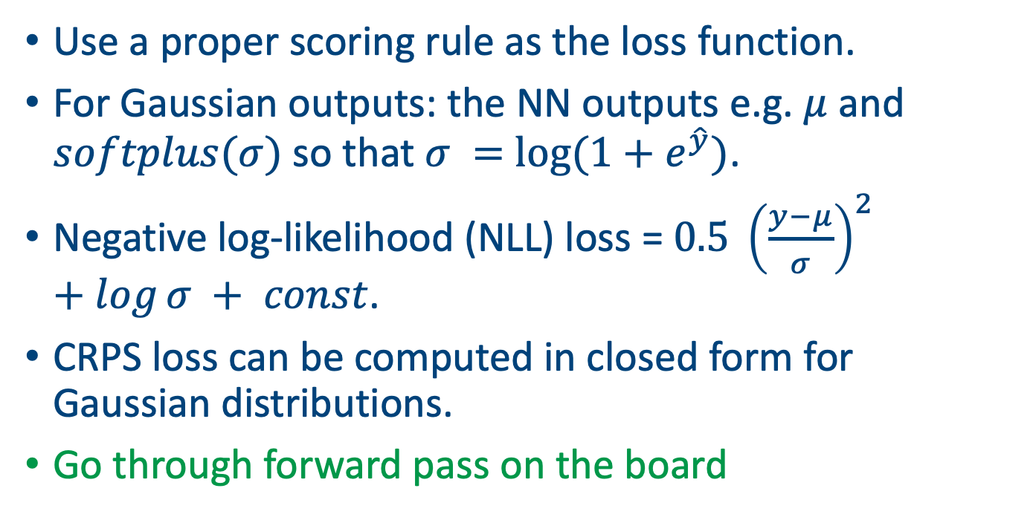
Probabilistic Output Layers
Use a proper scoring rule as the loss function.
For Gaussian outputs: the NN outputs e.g. $μ$ and $softplus(σ)$ so that $σ =$ $log(1+e^{\hat{y}})$.
Negative log-likelihood (NLL) loss = $0.5 {\left(\frac{y−μ}{σ}\right)}^{2} +log⁡σ + const$.
CRPS loss can be computed in closed form for Gaussian distributions.
Go through forward pass on the board

Slide 10
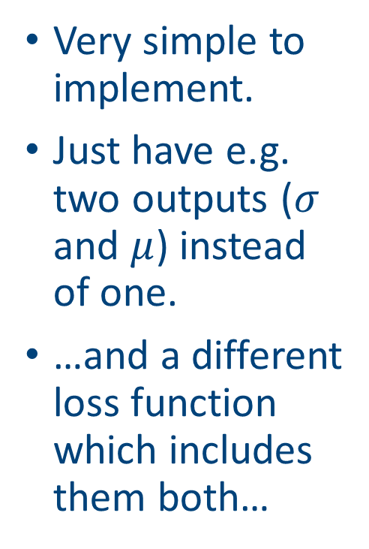
Probabilistic forecasting in PyTorch
Very simple to implement.
Just have e.g. two outputs ($σ$ and $μ$) instead of one.
…and a different loss function which includes them both…
class TinyProbNN(nn.Module):
def __init__(self):
super().__init__()
self.h = nn.Linear(1, 1) # one hidden neuron
self.out = nn.Linear(1, 2) # [mu, raw_sigma]
def forward(self, x):
h = F.relu(self.h(x))
mu, raw_sigma = self.out(h).chunk(2, dim=1)
# ensure positivity; softplus is numerically stable
sigma = F.softplus(raw_sigma) + 1e-6
return mu, sigma

Slide 11
PyTorch part 2
def gaussian_nll(y, mu, sigma):
# NLL = 0.5*log(2πσ^2) + (y-μ)^2 / (2σ^2)
return 0.5*torch.log(2*math.pi*sigma**2) + 0.5*((y - mu)**2)/(sigma**2)
for epoch in range(1000):
mu, sigma = model(x)
loss = gaussian_nll(y, mu, sigma).mean()
opt.zero_grad()
loss.backward()
opt.step()

Slide 12
Adding probabilistic forecasting to other models
We can use this with LSTMs or Transformers to produce probabilistic forecasts of the next time step.
Just add the extra layers to the head and adjust the loss function to a proper scoring rule.
Be sure to check that your output makes sense.
Can be applied to all the other models we have met (and many more that we haven’t).

Slide 13
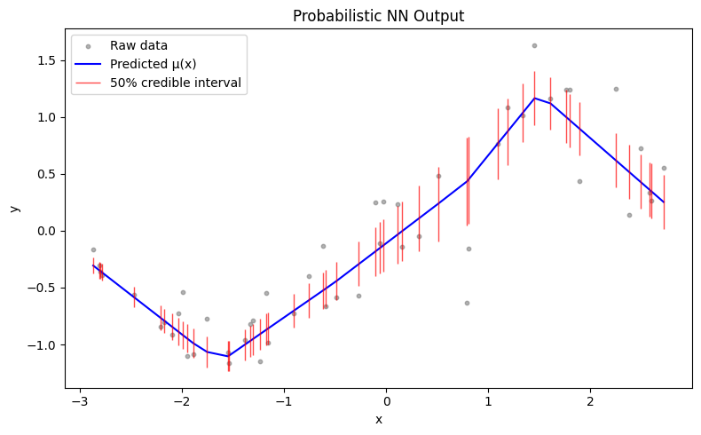
Example: simple ANN with PyTorch
Created via Super_simple_probabilistic_ANN.ipynb

Slide 14
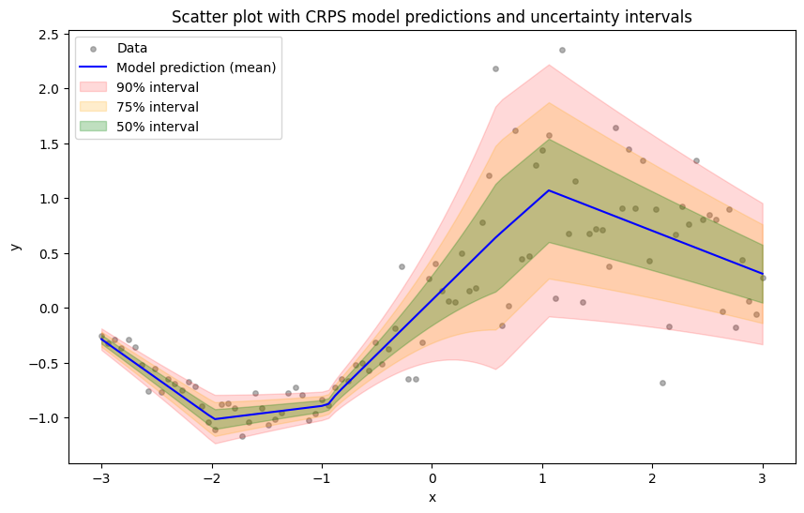
Pytorch results from CRPS fit
Created via Super_simple_CRPS_ANN.ipynb

Slide 15
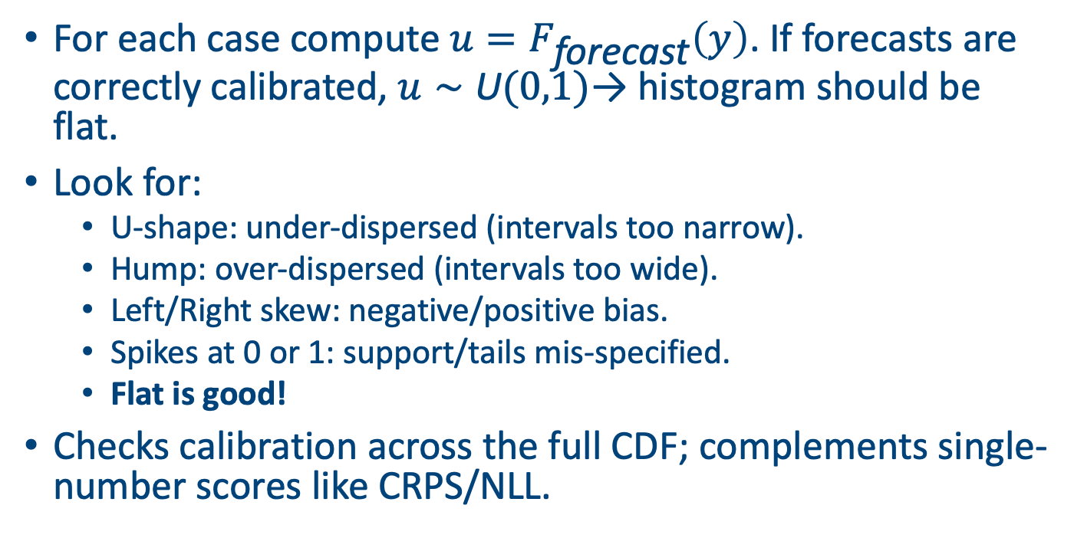
The Probability Integral Transform (PIT) Histogram
For each case compute $u=F_{\text{forecast}}\left(y\right)$. If forecasts are correctly calibrated, $u∼\text{U}(0,1)$→ histogram should be flat.
Look for:
U-shape: under-dispersed (intervals too narrow).
Hump: over-dispersed (intervals too wide).
Left/Right skew: negative/positive bias.
Spikes at 0 or 1: support/tails mis-specified.
Flat is good!
Checks calibration across the full CDF; complements single-number scores like CRPS/NLL.

Slide 16
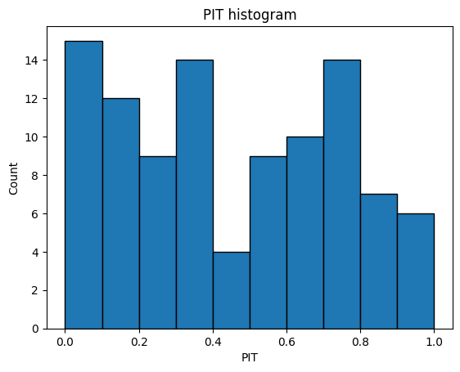
The PIT for our data
A bit skewed
Might need a richer model?
Increase the number of hidden layers or the complexity of the NN

Slide 17
Other approaches
Mixture Density Networks (MDN): output mixture weights, means & variances.
Quantile Regression Networks: output specific quantiles using pinball loss.
Generative models (GANs/VAEs): sample entire distributions.
Bayesian neural networks: place priors over weights to capture uncertainty.

Slide 18
Model averaging and ensembles
Averaging multiple models can improve calibration and sharpness.
Use ensembles of CNNs/LSTMs trained with different initialisations.
Alternatively combine models (including deterministic models) with probabilistic postprocessing (e.g., quantile regression).
Average CRPS (lower is better)

Slide 19
Limitations of probabilistic forecasting
Heavy tails and extreme events are difficult to model accurately.
Probabilistic calibration may fail under distributional shift.
Large computational cost of training CRPS/NLL losses for large models.
Can be harder to interpret and communicate probabilistic forecasts to stakeholders.

Slide 20
Summary
Probabilistic forecasts quantify uncertainty and enable risk‑aware decisions.
Proper scoring rules (Brier, Log, CRPS) provide objective loss functions that encourage calibration.
CNNs and LSTMs can be extended to output distribution parameters and trained with these scoring rules.
Calibration diagnostics (reliability diagrams, PIT histograms) are essential to evaluate forecasts.
Ensembles, proper hyperparameter tuning, and advanced models further improve probabilistic forecasts.

Slide 21
Topics we haven’t covered
Reinforcement learning: Learns policies via trial and error to potentially change how the model produces forecasts
Diffusion models: a generative approach that maps noise to e.g. realistic atmospheric states; enable ensemble generation, downscaling, and calibrated post-processing.
Transfer learning: Leverages pretrained models or neighboring regions to boost weather forecasts when e.g. station data are scarce.
Extremal NNs: Changing the loss function to match either univariate or (even better) multivariate extreme value models.

Slide 22
Next class
Run through D4C3_code.ipynb

Slide 23

Feedback please
https://forms.gle/7FTGrtsM6r9B3MXR8

Slide 24
Afternoon session instructions
Use some of the data sets in the data directory (or download your own)
Get an LLM to help you write a graph attention network to predict multiple variables across multiple slides
Stay small!
Present your file in 5 minutes

